Slide 1

JUnit
By: Tuan Hoang
Course duration: 3 hours
Last update: Jan 2008

Slide 2

Content
What is JUnit?
Where Does it Come From?
Working with TestCases
Working with TestSuites
JUnit Window
Confidential
Page ‹#›

Slide 3
Content by Staff Level
For 1-year engineer (junior engineer)
What is JUnit?
Where Does it Come From?
Working with TestCases
Working with TestSuites
JUnit Window
Confidential
Page ‹#›

Slide 4

What is JUnit?
Open source Java testing framework used to write and run repeatable automated tests
JUnit was written by Erich Gamma (of Design Patterns fame) and Kent Beck (creator of XP methodology)
JUnit can be used as stand alone Java programs (from the command line) or within an IDE such as Eclipse
Released under IBM's CPL
Confidential
Page ‹#›

Slide 5
Where Does it Come From?
JUnit’s web site: http://junit.org/index.htm
Eclipse includes JUnit
Eclipse provides new GUI to run JUnit test cases and suites
You can run your unit tests outside of Eclipse
If you wish using TestRunner
Using JUnit’s Window
Confidential
Page ‹#›

Slide 6
Terminology
A test fixture sets up the data (both objects and primitives) that are needed to run tests
Example: If you are testing code that updates an employee record, you need an employee record to test it on
A test case tests the response of a single method to a particular set of inputs
A test suite is a collection of test cases
A test runner is software that runs tests and reports results
An integration test is a test of how well classes work together
JUnit provides some limited support for integration tests

Slide 7
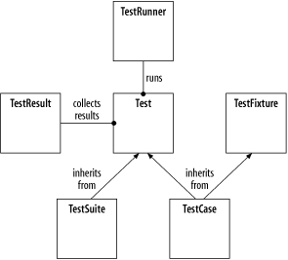
JUnit Architecture

Slide 8
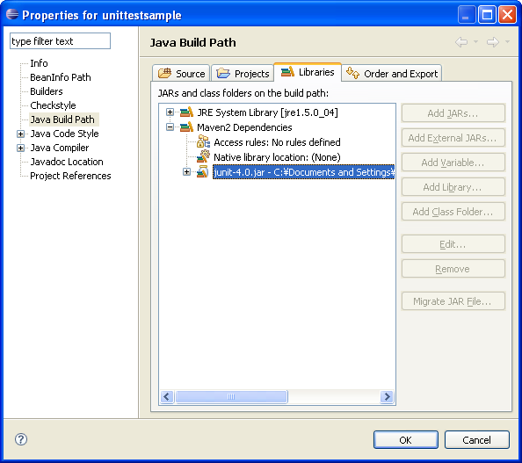
Eclipse JUnit Setup
JUnit reference can be set in project’s properties dialog
Confidential
Page ‹#›

Slide 9
JUnit Test Cases
Test case
Runs multiple tests
Implemented a subclass of TestCase
Define instance variables that store the state of the tests in the class
Initialize TestCase by overriding setUp method
Clean-up after test case is done by overriding tearDown method
Confidential
Page ‹#›

Slide 10
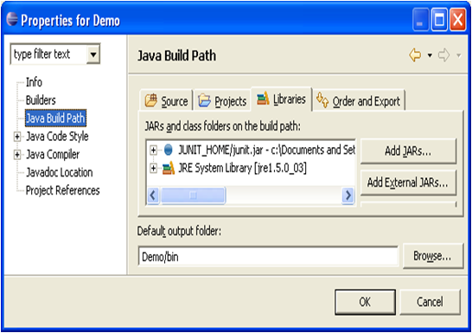
Creating TestCases in Eclipse…
Create a new package to contain your test case classes
Add the JUnit JAR file to the project’s buildpath
Or, will be done for you the first time you build a test case
Confidential
Page ‹#›

Slide 11
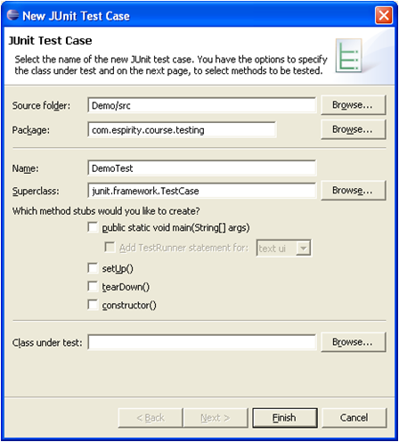
…Creating TestCases in Eclipse
Select your testing package
From the context menu select New 🡪 JUnit Test Case
In the next Window fill in the name of your test case
This will create the corresponding class in your testing package
Confidential
Page ‹#›

Slide 12
TestCase Template
package com.espirity.course.testing;
import junit.framework.TestCase;
public class FirstTestCase extends TestCase {
public FirstTestCase(String arg0) {
super(arg0);
}
public static void main(String[] args) {
}
protected void setUp() throws Exception {
super.setUp();
}
protected void tearDown() throws Exception {
super.tearDown();
}
}
Confidential
Page ‹#›

Slide 13
Adding Tests to TestCases
Any method in a TestCase class is considered a test if it begins with the word test
You can write many tests (have many test methods)
Each test method should use a variety of assert methods to test things about the state of their classes under tests
Assert methods are inherited
Confidential
Page ‹#›

Slide 14
Assert Methods
Assert methods include:
assertEqual(x,y)
assertFalse(boolean)
assertTrue(boolean)
assertNull(object)
assertNotNull(object)
assetSame(firstObject, secondObject)
assertNotSame(firstObject, secondObject)
assertArrayEquals(byte[] expecteds, byte[] actuals)
assertArrayEquals(char[] expecteds, char[] actuals)
fail(java.lang.String message)
Confidential
Page ‹#›

Slide 15
Adding Two Tests to TestCase
package testing;
import junit.framework.TestCase;
public class FirstTestCase extends TestCase {
public FirstTestCase(String arg0) {
super(arg0);
}
public static void main(String[] args) {}
protected void setUp() throws Exception {
super.setUp();
}
protected void tearDown() throws Exception {
super.tearDown();
}
public void testCompareSucceed() {
assertEquals(0, 0); //this assertion will succeed
}
public void testCompareFail() {
assertEquals(0, 1); //this assertion will fail
}
}
Confidential
Page ‹#›

Slide 16
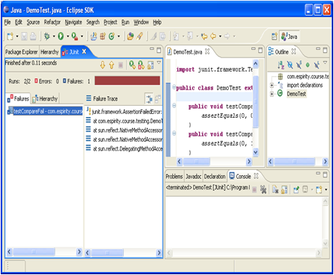
Running TestCase
Select TestCase class
From the Run menu select Run 🡪 Run As 🡪 JUnit Test
This will run the tests in your TestCase class along with the setup and teardown methods
You will then get a report in the JUnit Window
Confidential
Page ‹#›

Slide 17
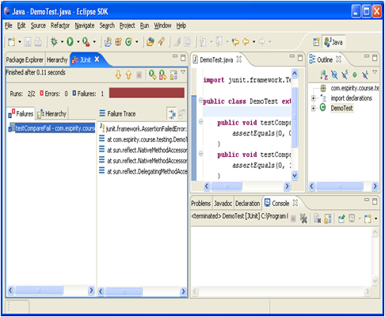
JUnit Window…
Red indicates a test has failed
If you wish to see the tests in TestCase click on the Hierarchy tab
You can see which test failed
You can see the call trace leading to the failure
Confidential
Page ‹#›

Slide 18

…JUnit Window
You can see how many tests ran
Errors occur when exceptions are thrown
How many failures occurred
You can see the details of the failure
Confidential
Page ‹#›

Slide 19
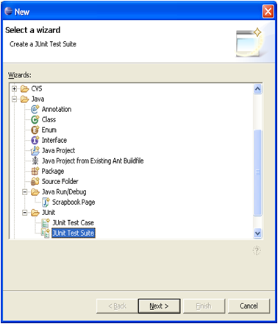
Creating JUnit TestSuite…
Test Suite
Runs multiple test cases or suites
Implemented as subclass of TestSuite
To create a TestSuite
Select your testing package
From the context menu select New 🡪 Other… 🡪 Java 🡪 JUnit
Then from the Wizard select JUnit Test Suite
Confidential
Page ‹#›

Slide 20
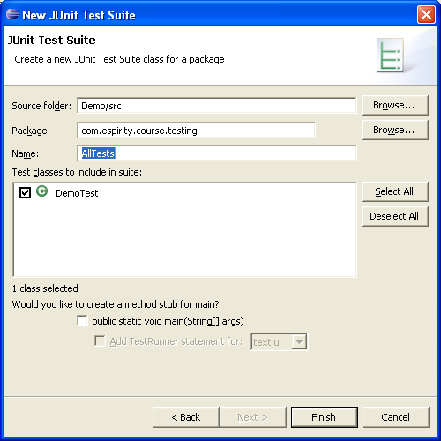
…Creating JUnit TestSuite
Fill in the name of your TestSuite Class
Select the TestCases to include in your TestSuite
Confidential
Page ‹#›

Slide 21
TestSuite Template
package com.espirity.course.testing;
import junit.framework.Test;
public class AllInclusiveTestSuite {
public static Test suite() {
TestSuite suite =
new TestSuite("Test for com.espirity.course.testing");
//$JUnit-BEGIN$
suite.addTestSuite(FirstTestCase.class));
suite.addTestSuite(SecondTestCase.class));
//$JUnit-END$
return suite;
}
}
Confidential
Page ‹#›

Slide 22
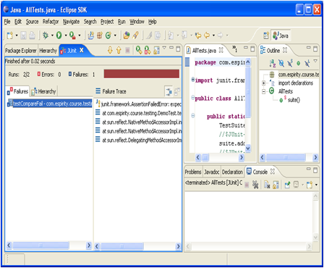
Running TestSuite
Select TestSuite class
From the Run menu select Run 🡪 Run As 🡪 JUnit Test
This will run the test cases in your TestSuite class
You will then get a report in the JUnit Window
Confidential
Page ‹#›

Slide 23
Interesting Point
The JUnit classes TestCase and TestSuite both implement the JUnit Test interface
Therefore, you can add JUnit TestSuites to other TestSuites
public static Test suite() {
TestSuite suite = new TestSuite("Test for testing");
//$JUnit-BEGIN$
suite.addTestSuite(FirstTestCase.class);
suite.addTestSuite(SecondTestCase.class);
suite.addTest(AllTests.suite());
//$JUnit-END$
return suite;
}
Confidential
Page ‹#›

Slide 24
Summary
You have learned:
What is JUnit
How it is integrated into Eclipse
How to write Test Cases
How to write Test Suites
How do use JUnit in Eclipse
Confidential
Page ‹#›

Slide 25

Question and Answer
Confidential
Page ‹#›

Slide 26
Exercise / Questionnaire

Slide 27
Appendix: Course detail form
Author | Tuan Hoang | Duration | 3 Hours
Category | Software Engineering | Type | Theory / Theory and Practice
Examination | Review questions / quiz will be at the end of the course. The purpose is to review the awareness of all attendees on some important points of this course
Intended Audience | Any software technician, engineer, project leader, project manager, manager who are working in software related projects.
Pre-requisites | Those who have basic knowledge of programming language and unit testing
Completion criteria for the course | Attendee must join at least 80% of course length and finish the review questions section with score rate of 75% or higher.
Criteria for granting training waivers | Those who has experience on JUnit, or already attended similar courses
Confidential
Page ‹#›

